Slide 1
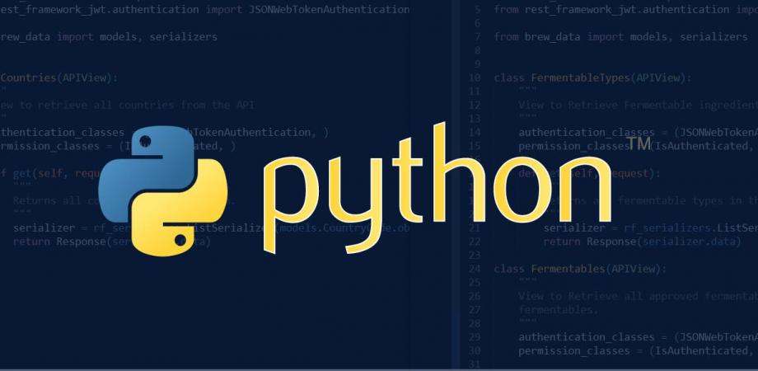


Perak Technology Session
Python: Dynamic Programming Language
Sponsor: Bandar Meru Raya Shop

Slide 2
Perak Technology
Perak ICT Community
Gather all ICT and technology expert from all over Perak.
Bring all ICT and technology event and program back to Perak State.
Boost ICT and technology industries in Perak.
Expose new technology and ICT services to Perak citizen.
Link: https://peraktechnology.com

Slide 3
Bandar Meru Raya Shop
Bandar Meru Raya Shop encourage startups and e-commerce entrepreneurs to do online business using social media.
Promote to Perak citizen for fully utilize the latest technology in daily life.
Turn Bandar Meru Raya into the centre of the online marketplace in Perak by the end of 2019.
Link: https://bandarmeruraya.com

Slide 4
Perak Technology Session
Knowledge sharing program for Perak Technology community
Run in different city in Perak every two month.
Sponsored by Bandar Meru Raya Shop and any other related company.
Allow Perak Technology community member to present any ICT and technology related stuff.
Open for sponsorship and support from local community
Link: http://telegram.me/peraktechnology

Slide 5
Python Programming
Simple and easy to learn programming.
Python is an interpreted, object-oriented, high-level programming language with dynamic semantics.
Built in data structures with dynamic typing and dynamic binding.
Suitable for Rapid Application Development and scripting
Python supports modules and packages for program modularity and code reuse.
Link: https://python.org

Slide 6
Syntax
File Extention: .py
Indentation:
>>> if True:
>>> print("True")
>>> else:
>>> print("False")

Slide 7
Syntax
Printing Output:
>>> print("Welcome to Perak Technology")
Welcome to Perak Technology
Reading Input
>>> name = input("Enter your name: ")
>>> print(name)
Perak Technology

Slide 8
Syntax
Comment Single Line:
# print("Welcome to Perak Technology")
Reading Input:
'''
name = input("Enter your name: ")
print name
'''

Slide 9
Variables
No need to declare variable type
Declaration happen when assigning value
>>> counter = 100 # integer
>>> distance = 200.0 # float
>>> name = "Perak Technology" # string
>>> z = None # null

Slide 10
Variables
Change variable type by assign new value
>>> counter = 100 # integer
>>> counter = "One Hundred" # string

Slide 11
Variables
Allow assign single value to multiple variable
>>> a = b = c = 100 # all 3 value is 100
Assign multiple object to multiple variables
>>> a, b, c, = 10, 120.0, "Perak Technology"

Slide 12
Types (Numbers)
Numbers:
Integer
Float
Common number function:
>>> int(x) # change x to integer
>>> float(x) # change x to float
>>> abs(x) # get x absolute value

Slide 13
Types (String)
Update string by assign value to another string
Not support character type, character a treated as string with length 1
Support single('), double(") or triple (''' or """)
Indexes start at 0 from the begining of the string and start at -1 from the end of string.

Slide 14
Types (String)
Formatting:
>>> num = 2232
>>> str = "{} Perak Technology Members".format(num)
>>> print(str)
2232 Perak Technology Members

Slide 15
Types (String)
Example Value
>>> a = "Salam"
>>> b = "Perak Technology"
Concatenation
>>> a + b
SalamPerak Technology
Repetition
>>> a * 2
SalamSalam

Slide 16
Types (String)
Example Value
>>> a = "Salam"
Slice
>>> a[1]
a
>>> a[-1]
m
Range Slice
>>> a[1:4]
ala

Slide 17
Types (String)
Common String Method
str.count()
str.isalpha()
str.isdigit()
str.lower()
str.replace(old,new)
str.split(str=' ')
str.strip()
len(str)

Slide 18
Types (Lists)
Ordered group of items or elements
Don't have to be same type
Item separated by comma and enclosed with square bracket
>>> list = ["Perak", "Technology", "No.", 1]
>>> print(list[0])
Perak
>>> list[2] = "Best"
>>> print(list)
["Perak", "Technology", "Best", 1]

Slide 19
Types (Tuples)
Cannot be changed once created
Item separated by comma and enclosed with parentheses instead of square bracket
Faster than lists and protect against accidental changes
>>> t = ("Perak", "Technology", "No.", 1)
>>> print(t[1])
Technology
>>> t[2] = "Best"
TypeError: 'tuple' object does not support item assignment

Slide 20
Control Flow (Condition)
if Statement
>>> if expression:
>>> statement(s)
if...else Statement
>>> if expression:
>>> statement(s)
>>> else:
>>> statement(s)
if...elif...else Statement

Slide 21
Control Flow (Condition)
if...elif...else Statement
>>> if expression1:
>>> statement(s)
>>> elif expression2:
>>> statement(s)
>>> else:
>>> statement(s)

Slide 22
Control Flow (Condition)
Example
>>> a = 2
>>> b = 5
>>> if a > b:
>>> print("Larger")
>>> elif a < b:
>>> print("Smaller")
>>> else:
>>> print("Equal")
Smaller

Slide 23
Control Flow (Loops)
For Loops
>>> for letter in "Perak":
>>> print("Current letter: ",letter)
Current letter: P
Current letter: e
Current letter: r
Current letter: a
Current letter: k

Slide 24
Control Flow (Loops)
While Loops
>>> count = 5
>>> while count > 0:
>>> print("Current count: ", count)
>>> count = count - 1
Current count: 5
Current count: 4
Current count: 3
Current count: 2
Current count: 1

Slide 25
Function
Syntax:
>>> def fuctionname(parameter):
>>> function_statement
>>> return [expression]
Example:
>>> def welcome(name):
>>> print("Welcome Home", name)
>>> return
>>>
>>> welcome("Perak Technology")
Welcome Home Perak Technology

Slide 26
Tools
Python IDE
PyCharm
Visual Studio Code
Sublime Text
Eclipse with PyDev
Vim

Slide 27
Tools
Python Web Frameworks
Django
Flask
Pyramid
Web2py

Slide 28
Jupyter Notebook
Open-source web application
Create and share documents contain live code, equations, visualizations and narrative text.
Data cleaning and transformation, numerical simulation, statistical modeling, data visualization, machine learning, and much more.
Link: https://jupyter.org/

